Slide 1
WALMART STORE SALES · DATA ANALYSIS MINI PROJECT
Walmart Sales Intelligence
Eight statistical experiments and a business-impact layer over 421,570 store-department-week sales records, published as an interactive dashboard.
421,570
45
81
143
records
stores
departments
weeks
Dashboard jeet-1236.github.io/walmart-sales-intelligence
Code github.com/jeet-1236/walmart-sales-intelligence
Notes:
A public Walmart dataset of weekly sales from 45 stores over two and a half years. The deck covers what we did, what we found, and the dashboard we built from it.

Slide 2
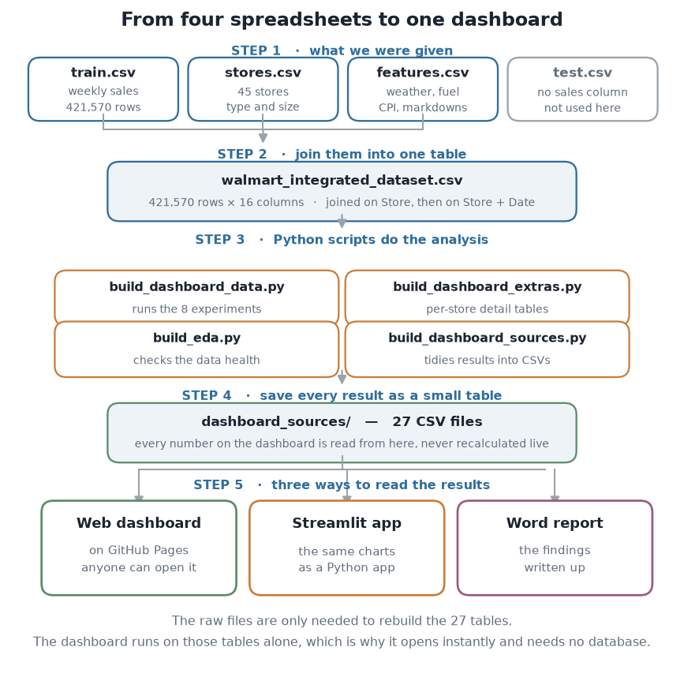
HOW IT WAS BUILT
From four spreadsheets to one dashboard
1 Collect
Four CSV files: sales, store details and weekly conditions.
2 Join
Merge into one table. One row is one department, in one store, in one week.
3 Clean
Fix data types, handle missing values, add the columns the analysis needs.
4 Analyse
Eight experiments in Python, from descriptive statistics to forecasting.
5 Publish
Save every result as a small table, then draw it as an interactive dashboard.
Notes:
The key design decision is step 5. Python does all the heavy work once and writes small tables. The dashboard only draws them, which is why it opens instantly and needs no server.

Slide 3
WHAT WE STARTED WITH
The dataset
Walmart Store Sales Forecasting — a public dataset of weekly sales from 45 stores, supplied as four files.
train.csv
Weekly sales per store and department. The main file.
AFTER JOINING
421,570 × 16
stores.csv
Store type (A, B or C) and size in square feet.
rows × columns
45 / 81
stores / departments
features.csv
Temperature, fuel price, CPI, unemployment and five markdown columns.
143
weeks, Feb 2010 – Oct 2012
$6.74B
test.csv
Same shape but no sales column — not used, there is nothing to analyse.
total sales covered
One row means: one department, in one store, in one week.
Notes:
test.csv exists for a prediction competition. With the sales column removed there is nothing in it to analyse, so we left it out.

Slide 4
PREPROCESSING · 1 OF 2
Getting the data into shape
Merging
Type conversion
Missing values
Joined on Store, then on Store + Date. The second needs both keys because conditions change every week.
Dates to datetime, the holiday flag to boolean, the markdown columns to numbers.
Dropped rows with no sales figure. Kept the markdown gaps visible rather than silently zero-filling them.
Feature engineering
Duplicate check
Aggregation
Added Year, Month, Week-of-year, TotalMarkDown and a HasMarkDown flag.
Verified Store + Dept + Date appears exactly once. A bad join silently inflates every total.
Built store-week, store-department and chain-week summary tables for the different questions.
Notes:
Each technique is here for a reason, not for the sake of a checklist. Two are worth saying out loud: we detected outliers but did not remove them, and we centred within store-department before judging markdowns.

Slide 5
PREPROCESSING · 2 OF 2
Preparing it for modelling
Outlier detection
Standardisation
Dimensionality reduction
Flagged values outside the Tukey fences — and deliberately kept them, because they are the peak weeks.
Rescaled six features before K-Means. Without it, store size alone would decide every cluster.
Used PCA to squeeze six features into two, so the store groups can be drawn on a scatter plot.
Sampling
Within-group centring
Train / holdout split
Drew random, stratified and systematic samples at several sizes to test against the full dataset.
Removed each store-department's own mean before measuring the markdown effect.
Hid the final 13 weeks so the forecast could be tested on data it had never seen.
Notes:
Each technique is here for a reason, not for the sake of a checklist. Two are worth saying out loud: we detected outliers but did not remove them, and we centred within store-department before judging markdowns.

Slide 6
PART ONE
What the data told us
Before any modelling, we profiled every column. Three things changed how we read everything that followed.
Notes:
Exploratory data analysis comes before modelling for a reason: it is where you find the faults that would otherwise sit underneath every later conclusion.

Slide 7
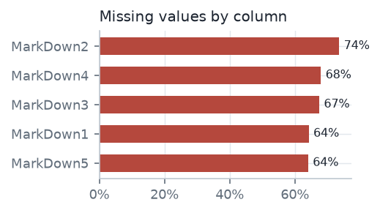
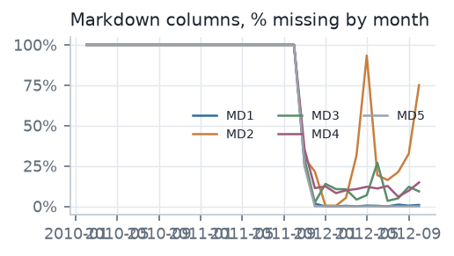
DATA QUALITY
Only 23% of rows are complete
Every gap is in the five markdown columns. They are empty for the first two years and only begin in November 2011.
WHY THIS MATTERS
Inside the window where markdowns are recorded, every single row has one. The data never shows a week with no discount, so “with discount versus without” cannot be measured here.
Notes:
We only found this by profiling the raw files. The joined file fills those gaps with zero, and zero reads as 'we discounted nothing' when the truth is 'nobody recorded it'.

Slide 8
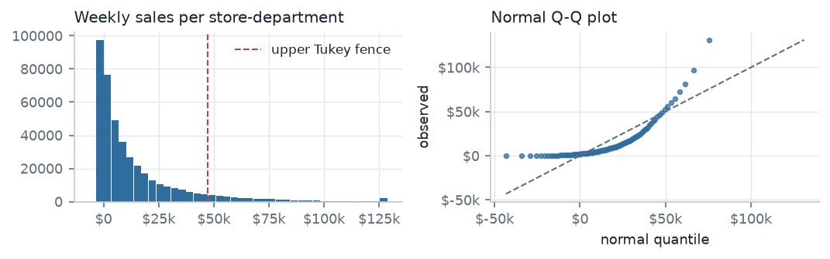
DISTRIBUTION
Sales are lopsided, and that is the business
3.3
skewness — a normal distribution would be 0
8.4%
of rows fall outside the Tukey fences
40%
of all revenue sits inside those rows
Normally you would remove outliers. Here you must not — removing them would delete Christmas.
Notes:
The average weekly sale per department is about $16,000 but the middle value is only $7,600. A few enormous weeks pull the average up.

Slide 9
PART TWO
Four findings that change a decision
Each one contradicts the obvious reading of the data.
Notes:
These four were chosen because each one would lead to a different decision than the obvious reading of the same chart.

Slide 10
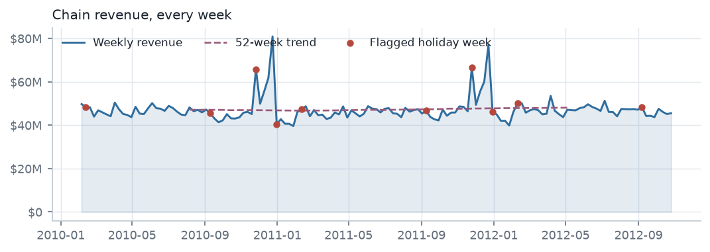
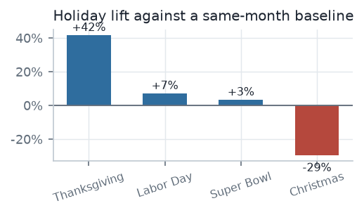
FINDING 1
The holiday flag points at the wrong weeks
The flag marks a trough
It lands on the week ending 31 December — the dead week after Christmas, about 29% below its December baseline.
The real peak is unflagged
Week 51, the pre-Christmas week, is the biggest week of every year and carries no flag at all.
What to do
Replace the flag with named holidays and a week-of-year index before forecasting.
Notes:
Three of the five biggest weeks on record are labelled normal. Any model trained on this flag as-is learns the wrong calendar.

Slide 11
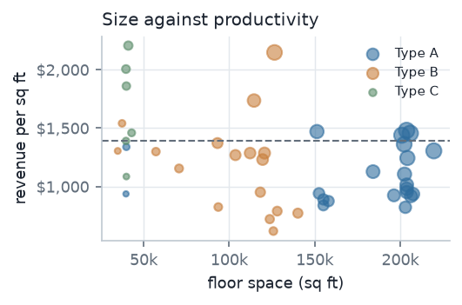
FINDING 2
The smallest stores work the hardest floor space
Type A takes 64% of revenue because it has most of the square footage. Per square foot the ranking reverses.
Type C
$1,667
6 stores, ~40k sq ft
Type B
$1,163
17 stores, ~101k sq ft
Type A
$1,111
22 stores, ~177k sq ft
Revenue per square foot. Size and productivity rank in opposite directions.
Notes:
This holds at median-store level too, so it is not an artefact of totalling. ANOVA across the three formats gives F of about 7,800.

Slide 12
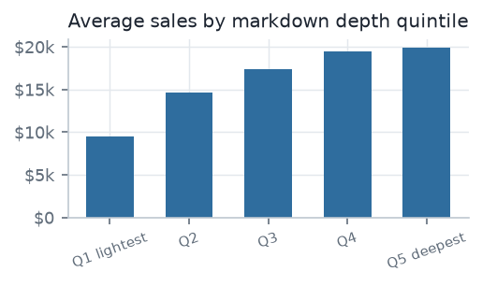
FINDING 3
Markdown's effect is mostly store size
What the raw chart suggests
The deepest markdown quintile averages 110% more sales than the lightest. That looks like a powerful promotion effect.
What is actually happening
Large departments receive large markdowns and already sell more. Remove each store-department's own average and the effect nearly vanishes.
$0.015
of sales per markdown dollar, measured within store-department. It explains 0.1% of a store's own week-to-week swing.
Nothing here identifies a causal promotion effect. That needs a holdout group the data does not contain.
Notes:
This is the finding most likely to be read the wrong way. The cross-sectional curve is real but it is confounding, not causation.

Slide 13
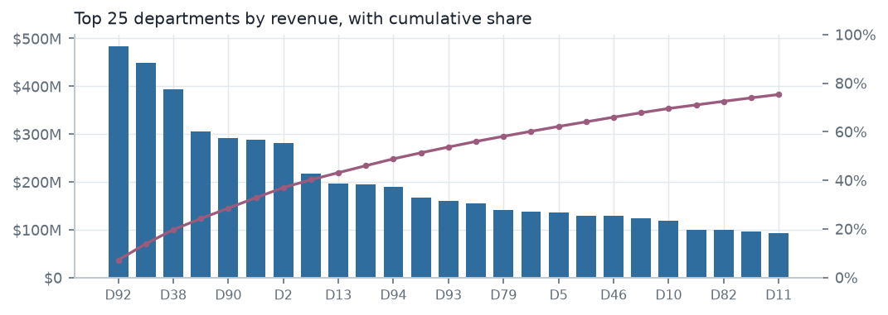
FINDING 4
A few departments carry the chain
29 of 81
departments produce 80% of all revenue
46%
of revenue sits in the top ten departments
8.7%
Protect assortment and shelf space in the top decile. Review the long tail for consolidation.
is all the bottom half contributes together
Notes:
Department 92 alone carries 7.2% of all revenue.

Slide 14
PART THREE
The dashboard
Everything above is on one screen, filterable, and public.
Notes:
The dashboard is the deliverable. The analysis behind it is only useful if someone can interrogate it without running any code.

Slide 15
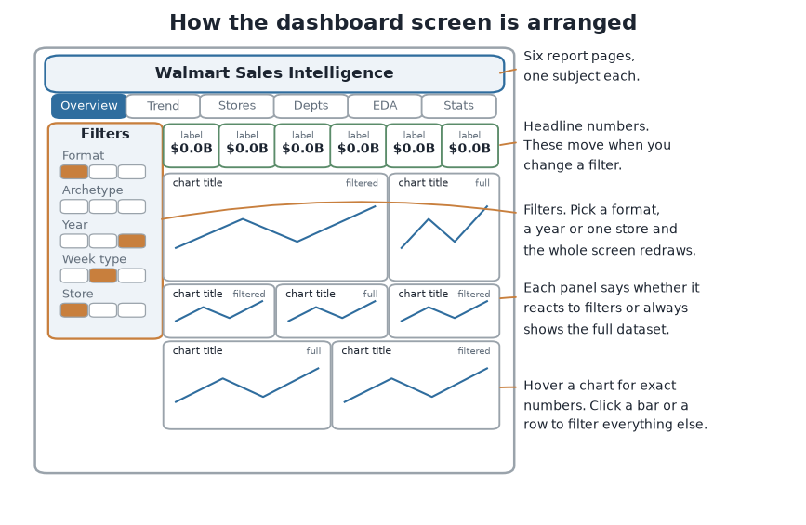
THE SCREEN
How the dashboard is arranged
Filters down the left
Store type, archetype, year, holiday or normal weeks, or one store.
Headline numbers on top
They recompute when you change a filter.
A grid of charts
Sixty panels across six pages. Almost no text.
Click to cross-filter
Clicking a bar, dot or row filters everything else.
An honest badge
Each panel says “filtered” or “full dataset”, so you always know.
Notes:
Laid out like Power BI or Tableau: slicers, KPI strip, panel grid. The charts do the talking rather than paragraphs of text.

Slide 16
WHAT IS ON IT
Six report pages
1
Overview
2
Trend and forecast
3
Stores
Weekly sales, a calendar of every week, the split by store type, top stores and departments.
The yearly rhythm, the long-term direction, and a 14-week forecast with its accuracy test.
All 45 stores on one scale, size against productivity, the archetypes, a sortable scorecard.
4
Departments
5
EDA profile
6
Statistics
Rankings, a block chart sized by sales, holiday performance, each store's mix.
Missing values, the shape of every column, the data quality checks.
Regression, sampling, distribution fitting and the significance tests.
Notes:
Each page answers one kind of question. The EDA page is unusual for a dashboard, but it lets a reader check the data before trusting the rest.

Slide 17
TOOLS
How it was built
Analysis
Python, pandas, NumPy, SciPy, scikit-learn
Joining, cleaning, statistics, regression and clustering
Charts
D3.js, Matplotlib, Plotly
Interactive charts on the dashboard; static ones in the reports
Delivery
Git, GitHub, GitHub Pages, Streamlit
Version history, free public hosting, plus a Python app version
Python does the thinking once and writes 27 small tables. The browser only draws them — about 300 KB in total, which is why the dashboard opens instantly and needs no server.
Notes:
The separation between computing and drawing is the main architectural decision in the project.

Slide 18
LIMITATIONS
What to be careful about
Discounts cannot be judged here
The holiday marker is unreliable
The headroom figure is a ceiling
The data has no discount-free period to compare against. Bigger discounts sit alongside bigger sales, but that is mostly store size.
It marks a quiet week and misses the busiest week of the year. We found this during the analysis and worked around it.
$1.69B assumes every store reaches top-quartile productivity. Catchment and competition cap what any store can do.
Significance is not importance
Clustering is descriptive
Two and a half years, one chain
At 421,570 rows nearly every test is significant. The holiday effect is real and negligible at the same time.
A silhouette of 0.265 means the four archetypes overlap. They describe, they do not partition.
Only two complete Christmases, and the stores are anonymous with no location data.
Notes:
Stating these plainly is part of the work. A result you cannot qualify is a result nobody should act on.

Slide 19
SEE IT YOURSELF
The dashboard is public
No sign-in, nothing to install. It opens in any browser.
Dashboard
Code, data and reports
jeet-1236.github.io/walmart-sales-intelligence
github.com/jeet-1236/walmart-sales-intelligence
The repository also holds three written reports: a three-page summary, a plain-language walkthrough of the process, and the full analytical write-up.
Notes:
Everything in this deck is reproducible from the repository: the scripts rebuild the tables, and the tables feed the dashboard, the reports and these slides.

